Slide 1
CNN and Feature Visualization
CSC 249/449 Spring 2019
http://www.cs.rochester.edu/~cxu22/t/249S19/
Instructor: Chenliang Xu
chenliang.xu@rochester.edu

Slide 2
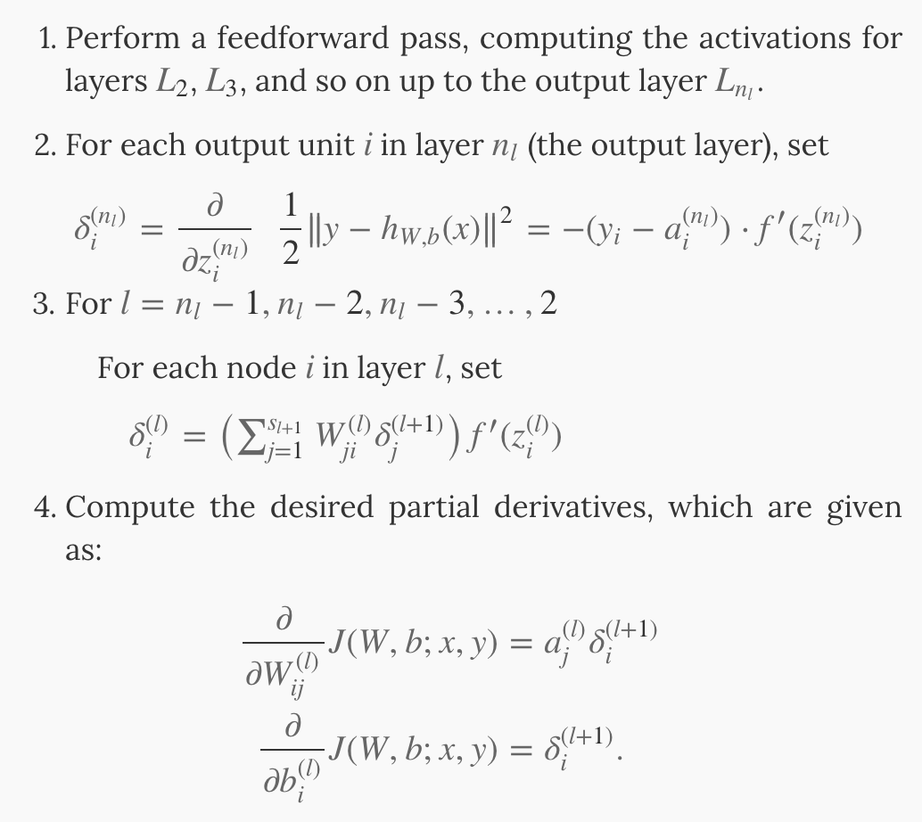
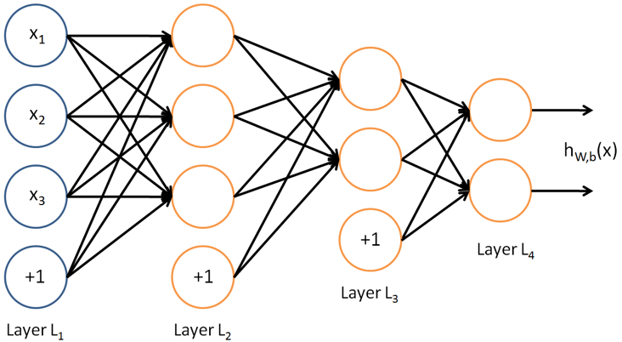
BP example with one-half squared loss
Feedforward pass

Slide 3
BP example with one-half squared loss
Backpropagation
Loss
Ground-truth y

Slide 4
BP example with one-half squared loss
Backpropagation
W¹
W²
W³
Loss
b¹
b²
b³
Ground-truth y

Slide 5
BP example with one-half squared loss
Backpropagation
W¹
W²
W³
Loss
b¹
b²
b³
Ground-truth y
Need to save the activations

Slide 6
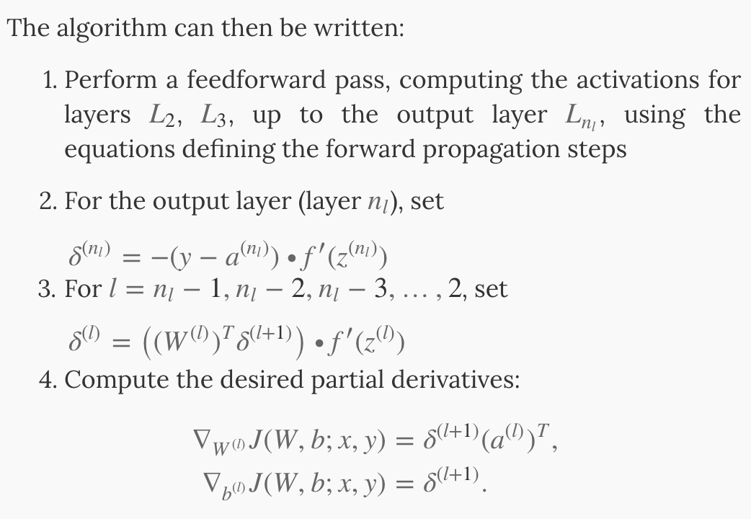
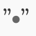
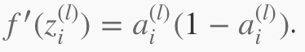
BP example with one-half squared loss
Matrix-vector operations
Backpropagation
W¹
W²
W³
Loss
b¹
b²
b³
Ground-truth y
Element-wise product operator
For sigmoid activation function:
Apply element-wise to vectors
How about others?

Slide 7
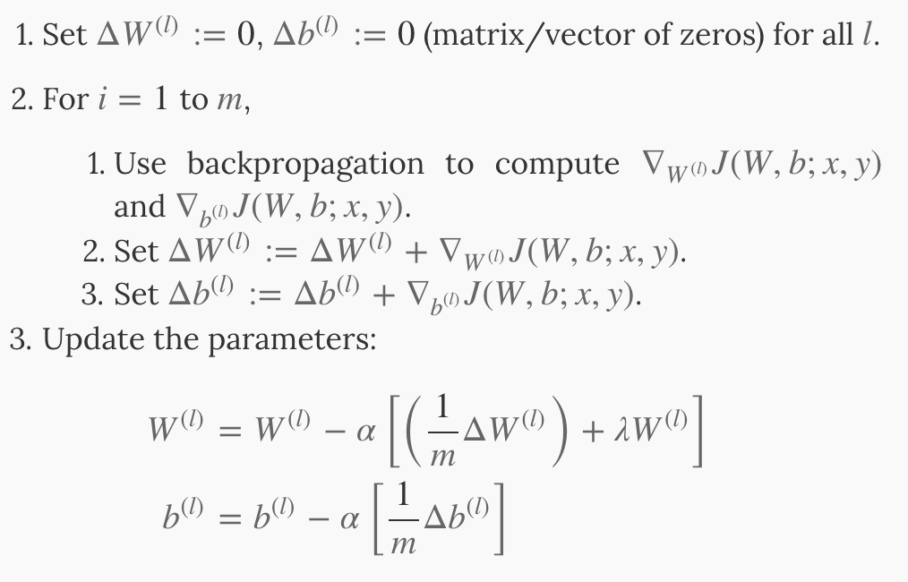
BP example with one-half squared loss
Pseudo-code for BP:
Backpropagation
k
For all examples in a batch
W¹
W²
W³
Loss
b¹
b²
b³
Ground-truth y
Why?

Slide 8
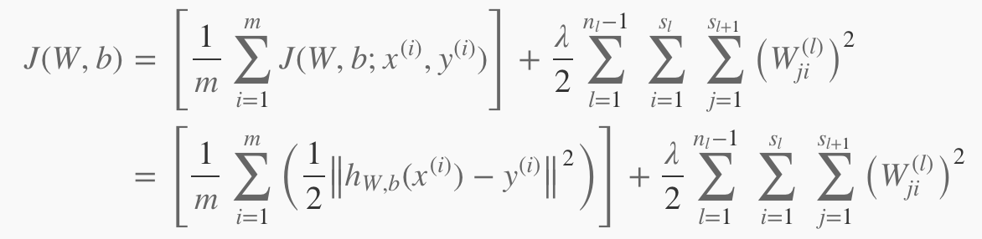
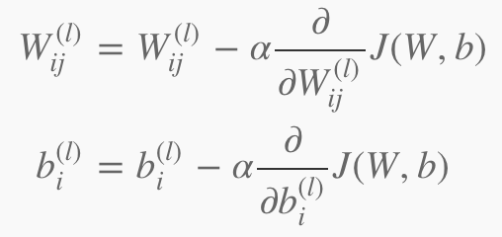
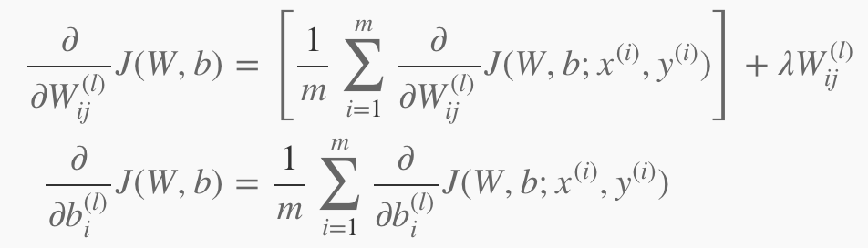
Recall…
Overall cost function:
GD updates parameters:
Weight decay

Slide 9
How about other losses?
One-half squared loss works well for regression problems and sometimes, classification.
How can we convert the output of our CNN into probability? Cross Entropy Loss!

Slide 10

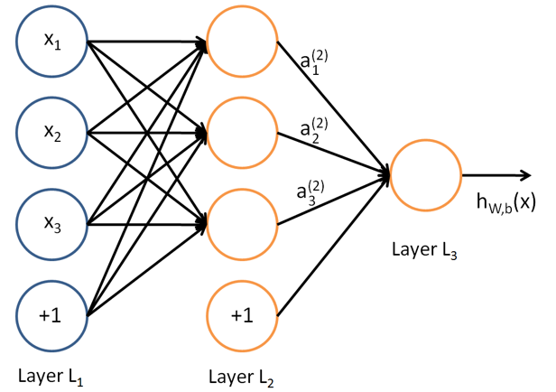
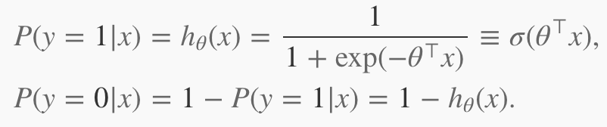
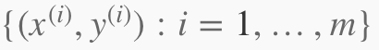
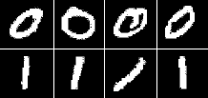
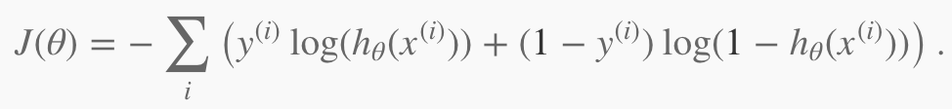
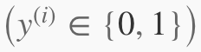
How about other losses?
Let’s look at the binary classification case.
Sigmoid or Logistic function
Our training set:
What should h(x) be for y=0 and y=1 in order to minimize J?

Slide 11

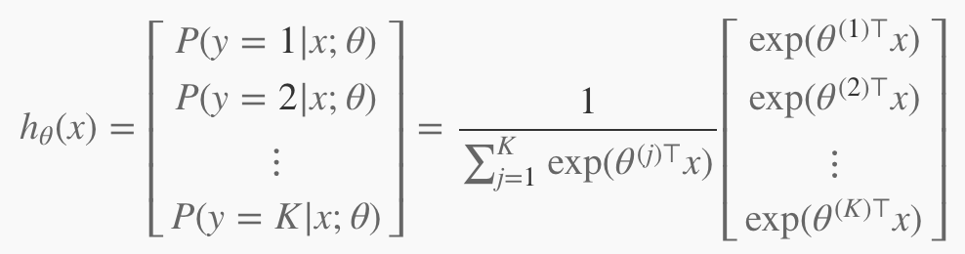
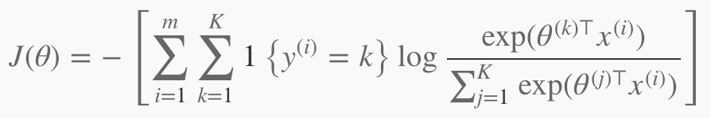
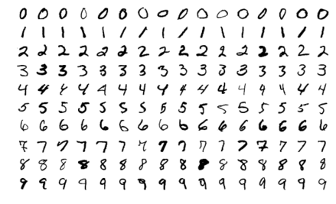
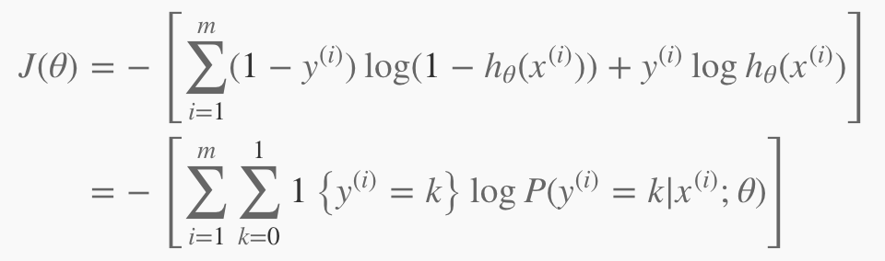
How about other losses?
Let’s look at the multi-class classification case.
Softmax:
Normalizes the dist.
Softmax cost function:
How this relates to binary cases?
Notes:
The exp in the softmax function roughly cancels out the log in the cross-entropy loss causing the loss to be roughly linear in thetaTx.

Slide 12
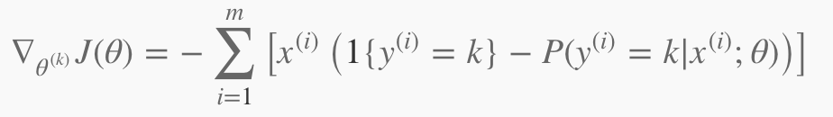
How about other losses?
Let’s look at the multi-class classification case.
Softmax:
Normalizes the dist.
Softmax cost function:
Notes:
The exp in the softmax function roughly cancels out the log in the cross-entropy loss causing the loss to be roughly linear in thetaTx.

Slide 13
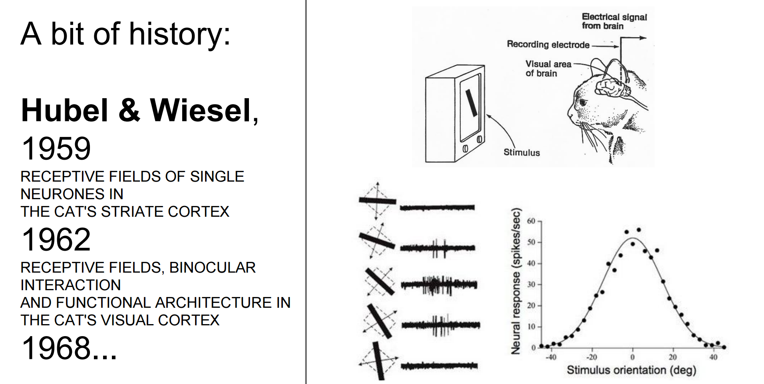
The Neuroscientific Basis for CNNs
Though CNNs have been guided by many other fields, some of the key design principles are drawn from neuroscience.
Nobel Prize
https://www.youtube.com/watch?v=8VdFf3egwfg&feature=youtu.be&t=1m10s

Slide 14
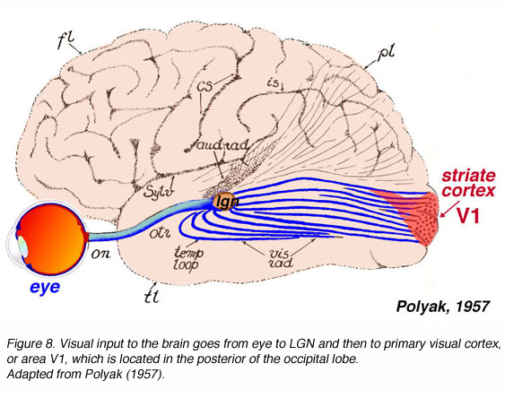
The Neuroscientific Basis for CNNs
In a simplified view, we focus on a part of brain called V1, also known as the primary visual cortex (first area of the brain that begins to perform significantly advanced processing of visual input).
Images are formed by light arriving in the eye and stimulating the retina (light-sensitive tissue in the back of the eye).
The neurons in the retina perform some simple preprocessing of the image but do not substantially alter it.
Then image passes through the optic nerve and the lateral geniculate nucleus (LGN) to arrive at V1 (back of the head).
Image credit: http://webvision.med.utah.edu/book/part-ix-psychophysics-of-vision/the-primary-visual-cortex/

Slide 15
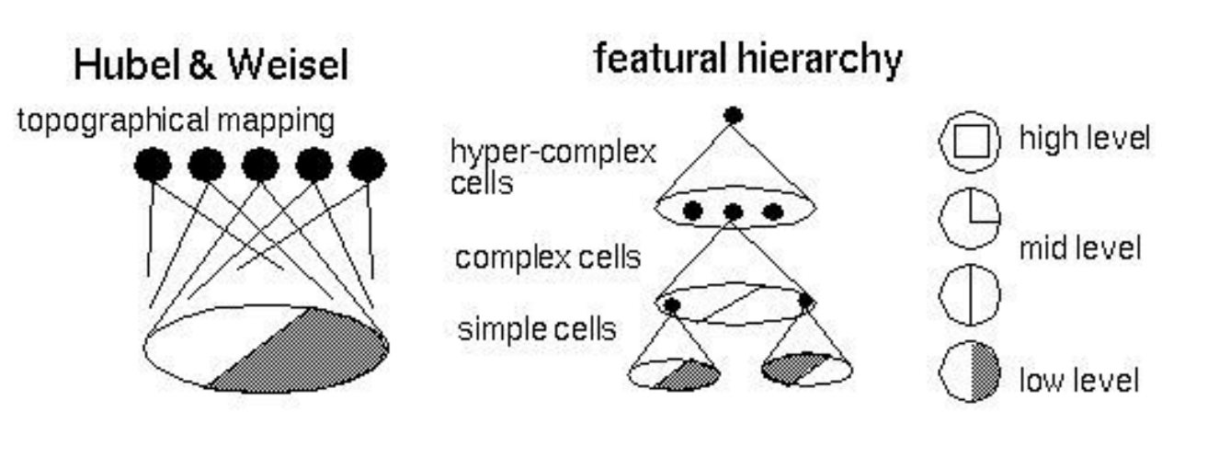
The Neuroscientific Basis for CNNs
A convolutional network layer is designed to capture three properties of V1:
V1 is arranged in a spatial map. A 2D structure mirroring the structure of the image in the retina. → CNNs having features defined in 2D maps.
V1 contains many simple cells. → To some extent be characterized by a linear function of the image in a small, spatially localized receptive field.
V1 also contains many complex cells. Similar to simple cells but invariant to small shifts, some changes of lighting. → Shifts: Max Pooling layer; Lighting: Cross-channel Pooling.

Slide 16
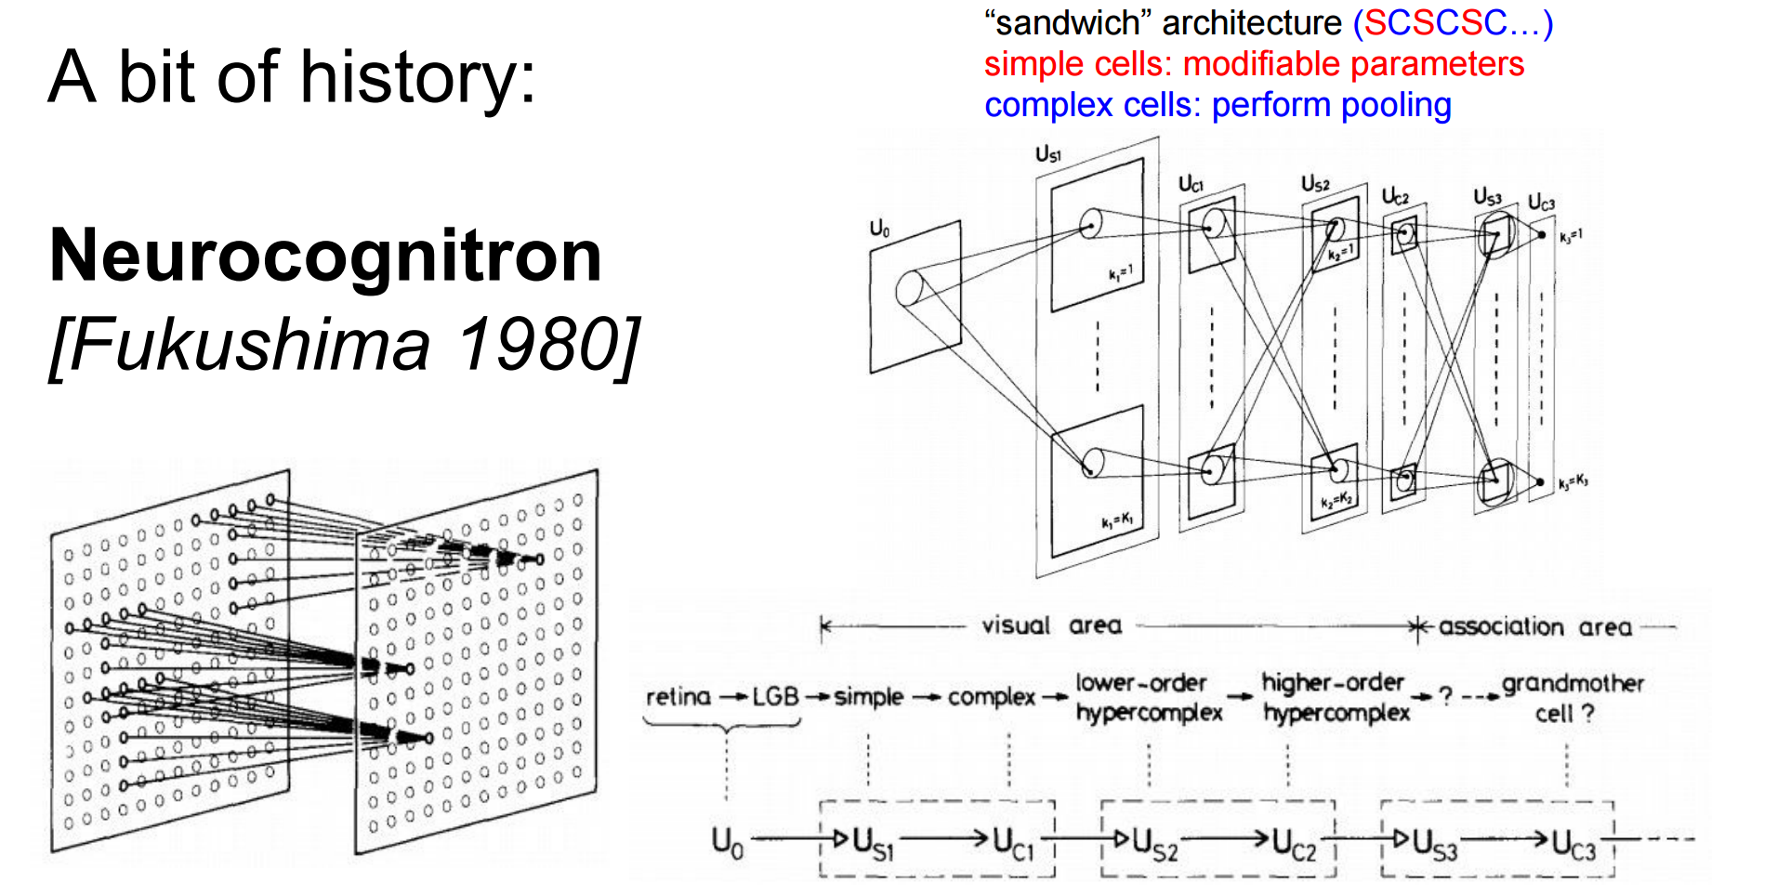
The Neuroscientific Basis for CNNs

Slide 17
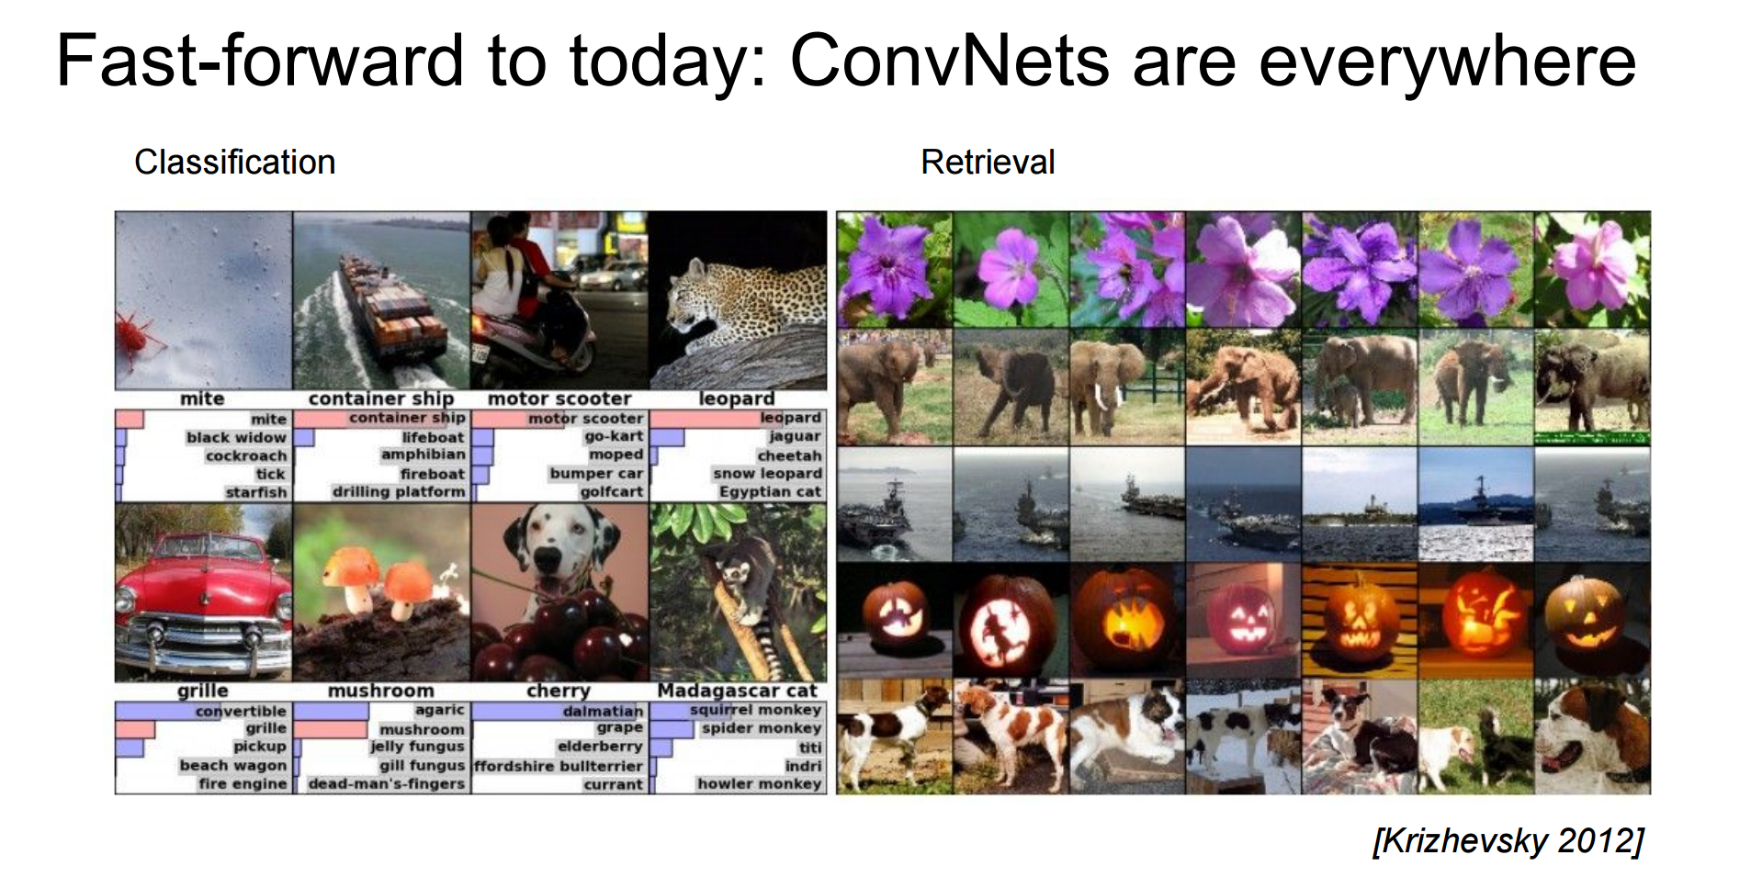
Application
Credit: Fei-Fei Li & Andrej Karpathy & Justin Johnson

Slide 18
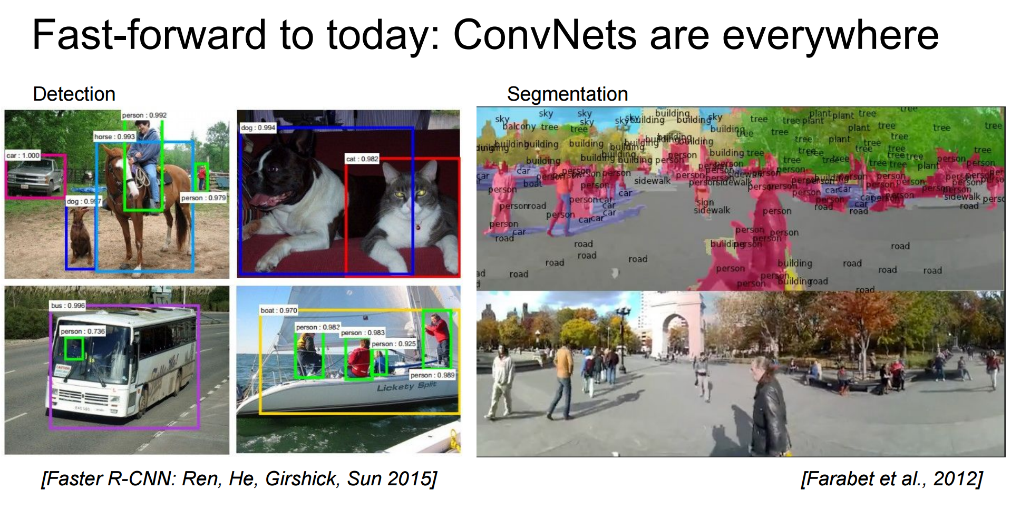
Application
Credit: Fei-Fei Li & Andrej Karpathy & Justin Johnson

Slide 19
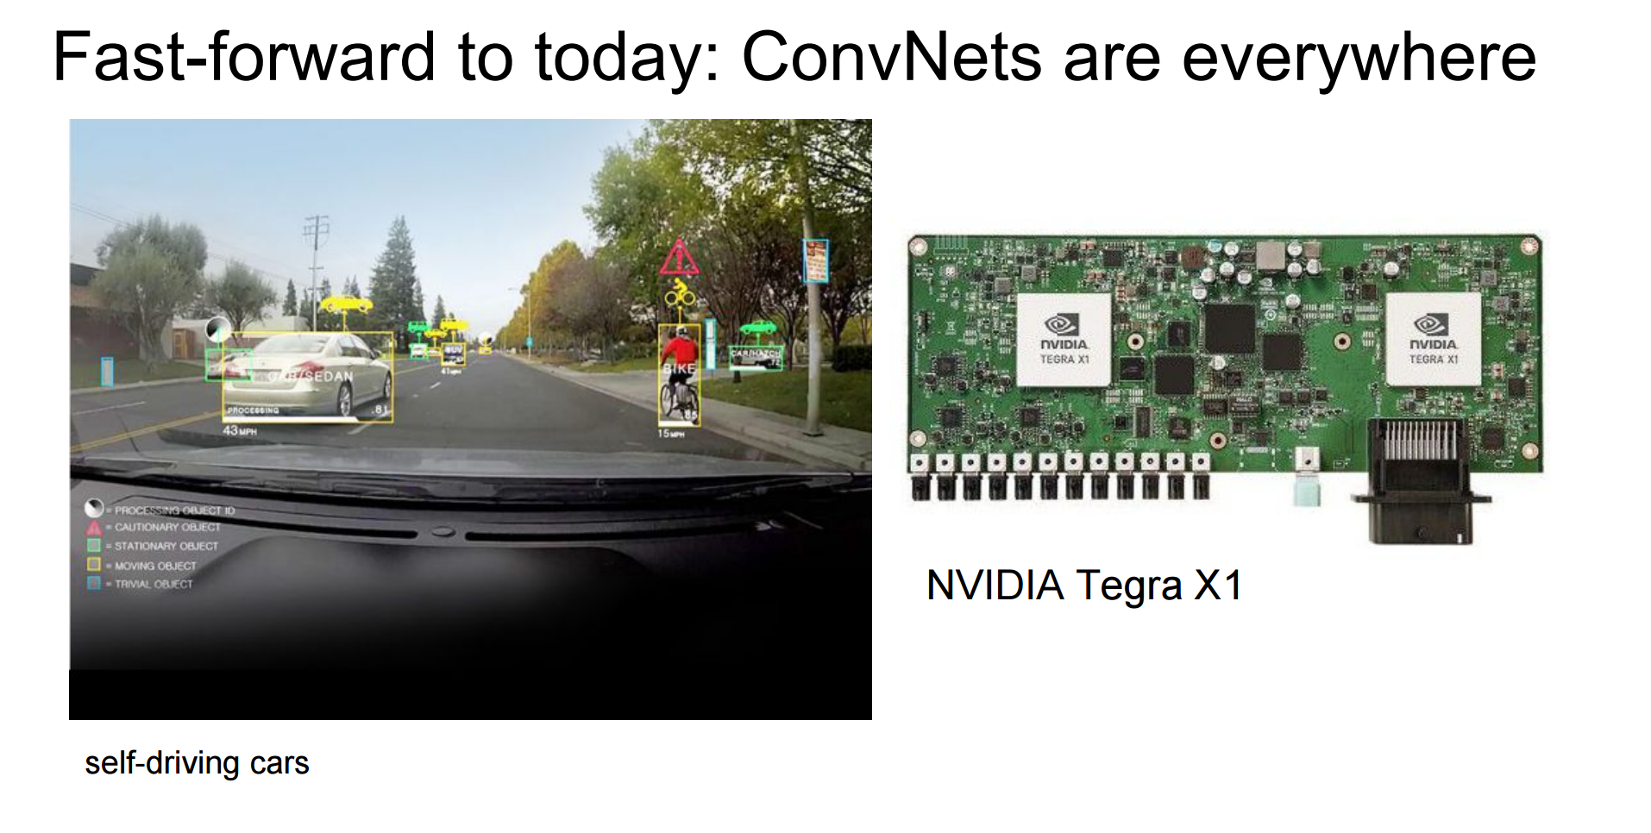
Application
Credit: Fei-Fei Li & Andrej Karpathy & Justin Johnson

Slide 20
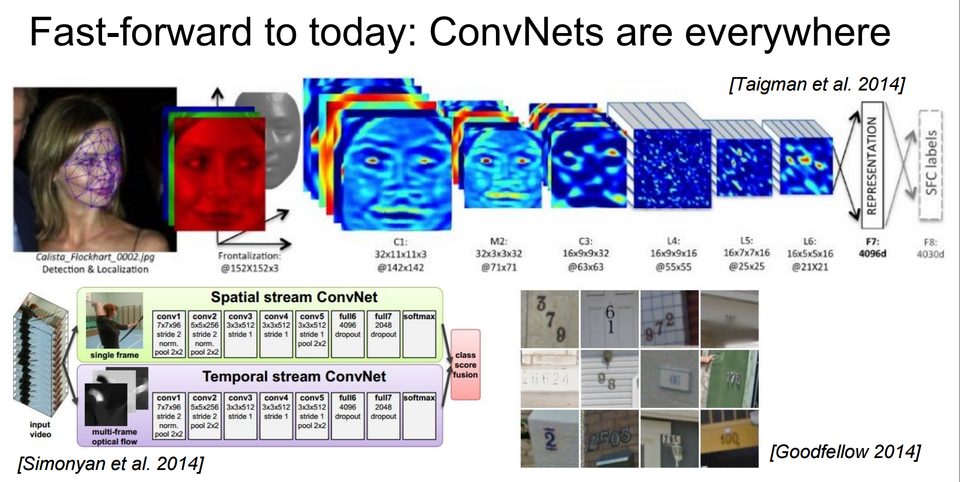
Application
Credit: Fei-Fei Li & Andrej Karpathy & Justin Johnson

Slide 21
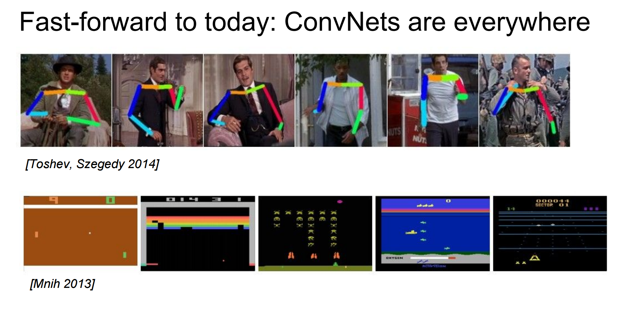
Application
Credit: Fei-Fei Li & Andrej Karpathy & Justin Johnson

Slide 22
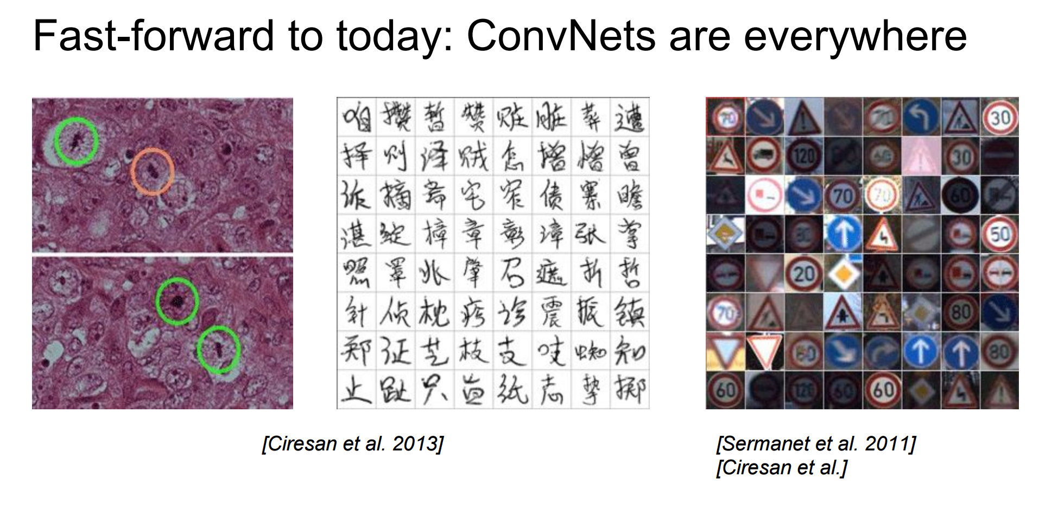
Application
Credit: Fei-Fei Li & Andrej Karpathy & Justin Johnson

Slide 23
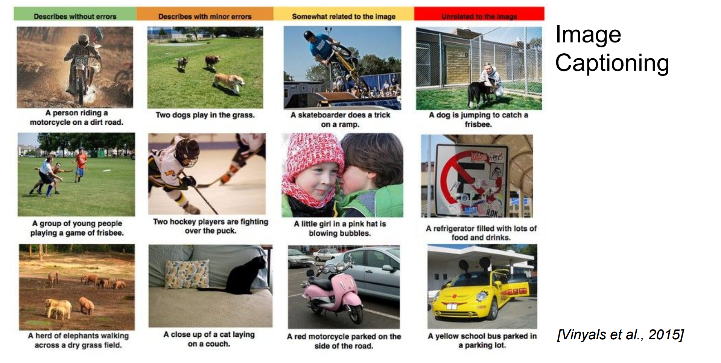
Application
Credit: Fei-Fei Li & Andrej Karpathy & Justin Johnson

Slide 24
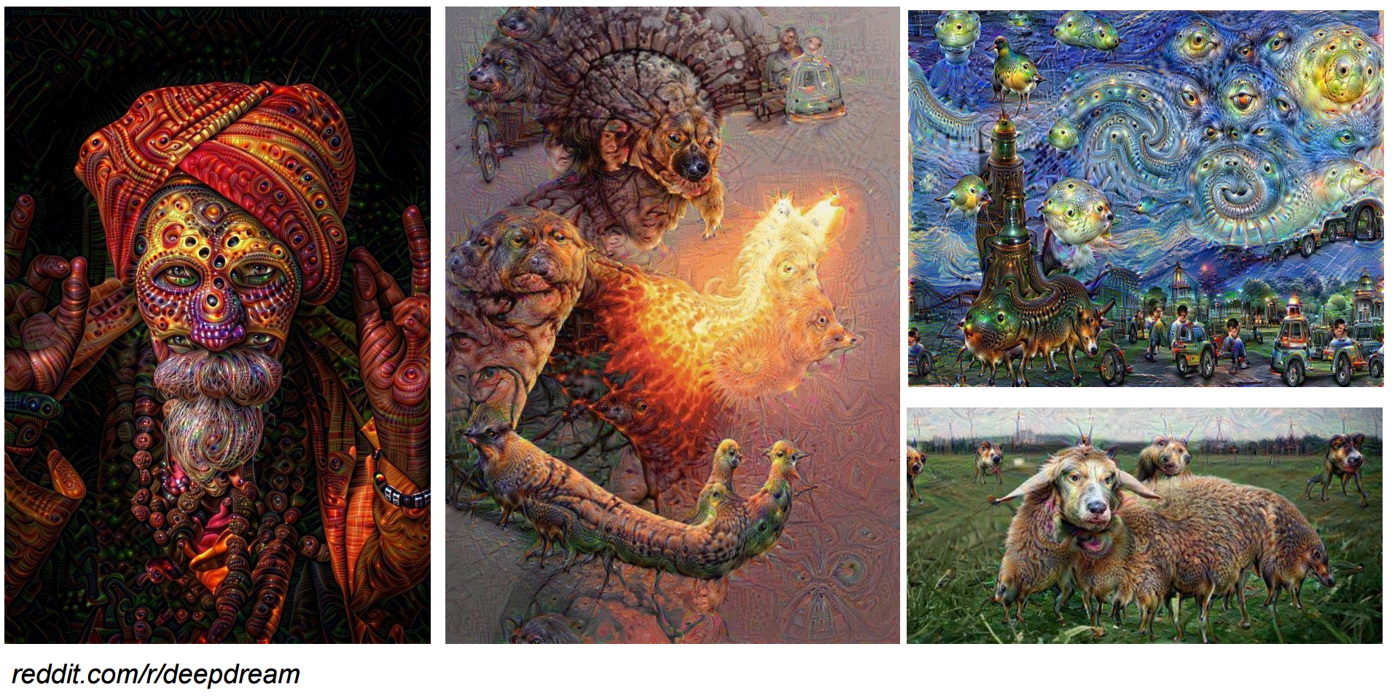
Application
Credit: Fei-Fei Li & Andrej Karpathy & Justin Johnson

Slide 25
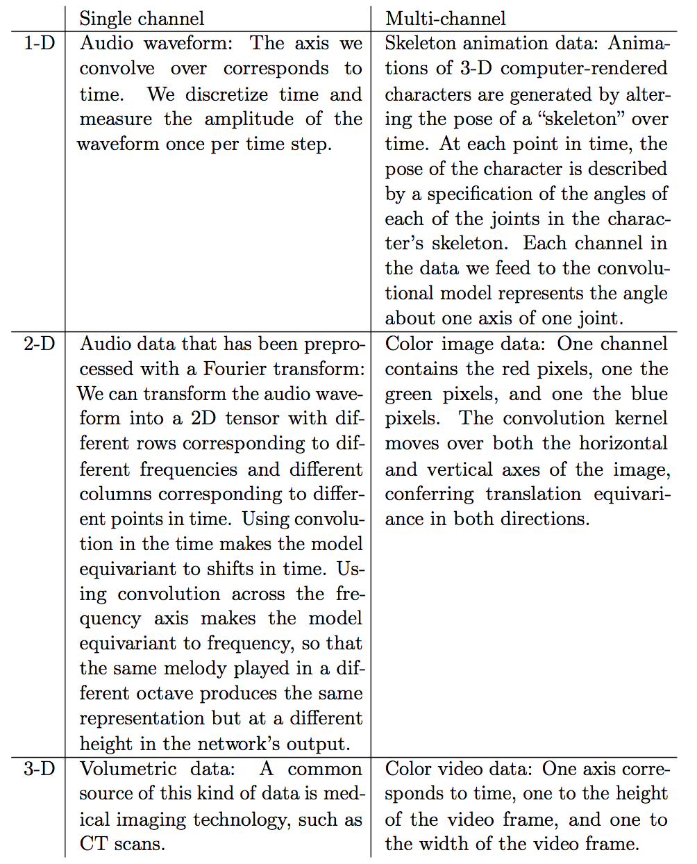
Data

Slide 26
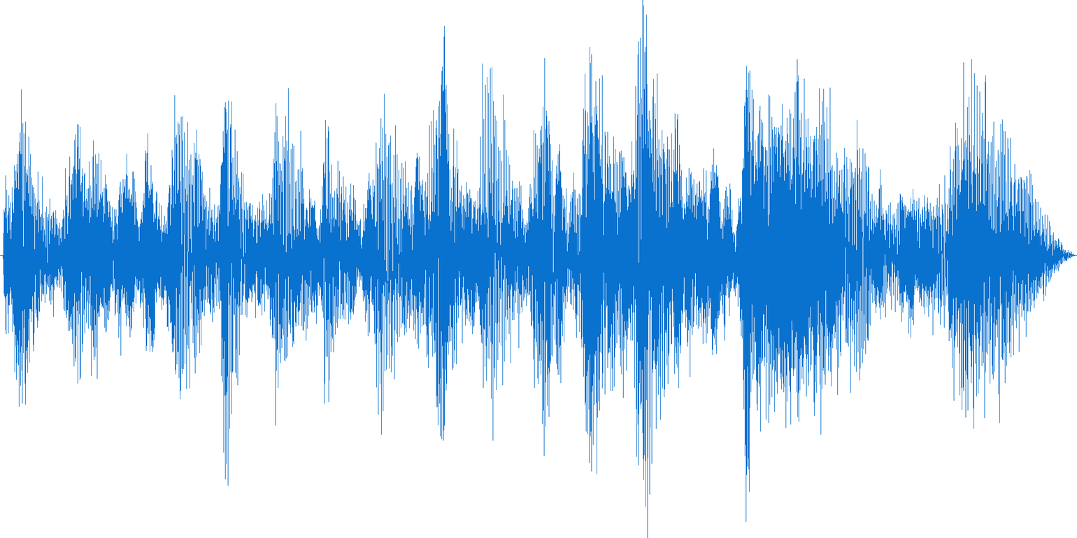
Data
Audio Waveform
Image credit: http://cloudinary.com/blog/how_to_
generate_waveform_images_from_audio_files

Slide 27
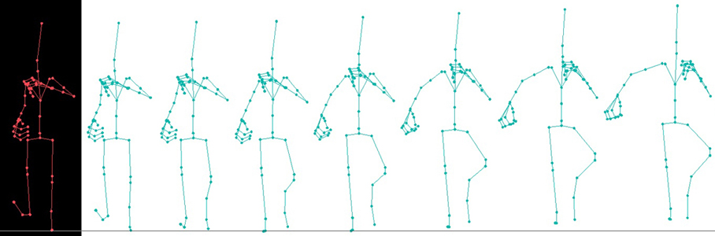
Data
Skeleton animation data
Image creidt: http://www.wazim.com/Collada_Tutorial_2.htm

Slide 28
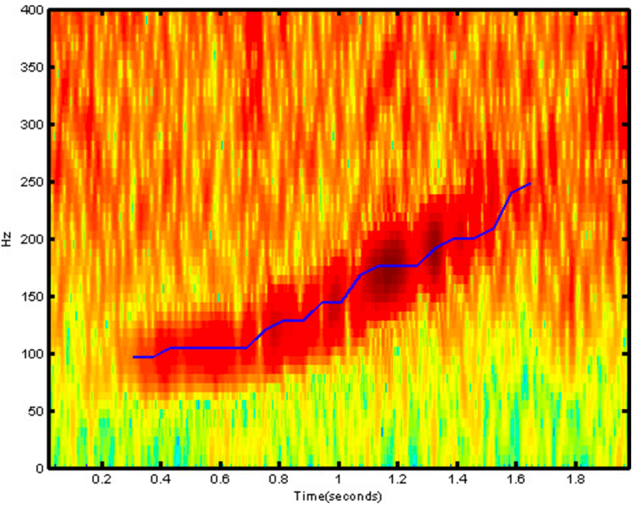
Data
Fourier Transform of Audio
Image credit: http://danielnouri.org/notes/2014/01/
10/using-deep-learning-to-listen-for-whales/

Slide 29
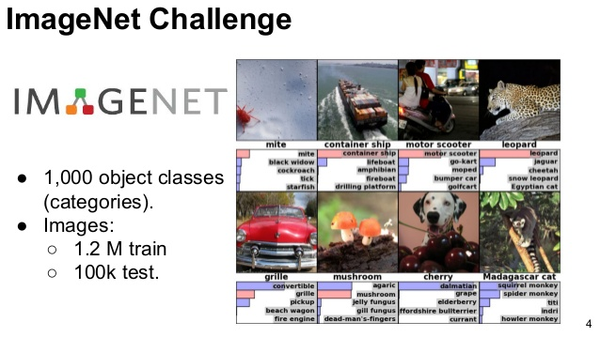
Data

Slide 30
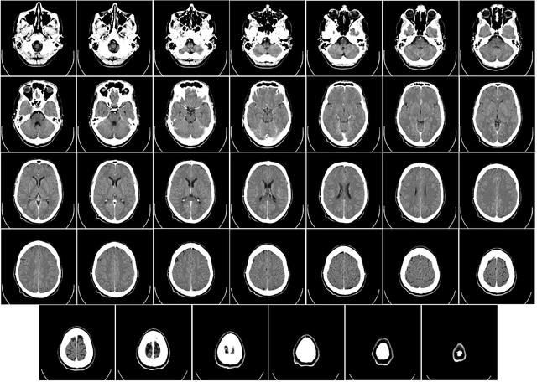
Data
CT Brain Scan
Image credit: https://en.wikipedia.org/wiki/
Computed_tomography_of_the_head

Slide 31
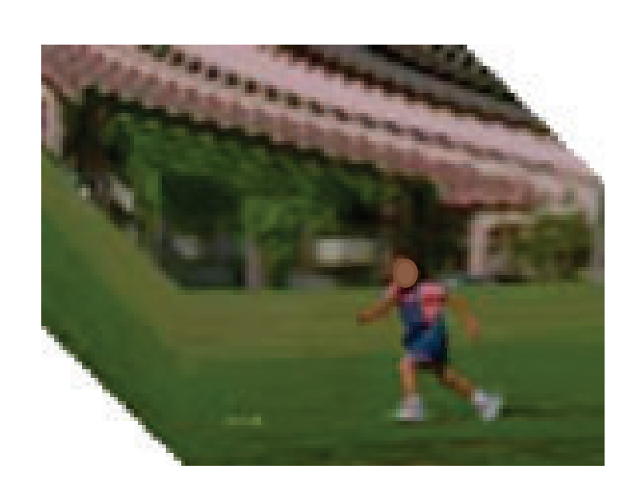
Data
Color Video Data
Image credit: SegTrack dataset

Slide 32
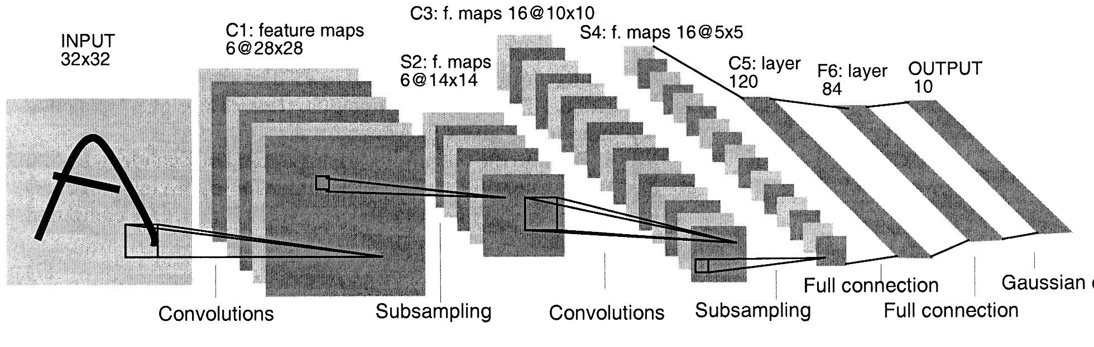
Convolutional Neural Networks
LeNet-5, LeCun 1989

Slide 33
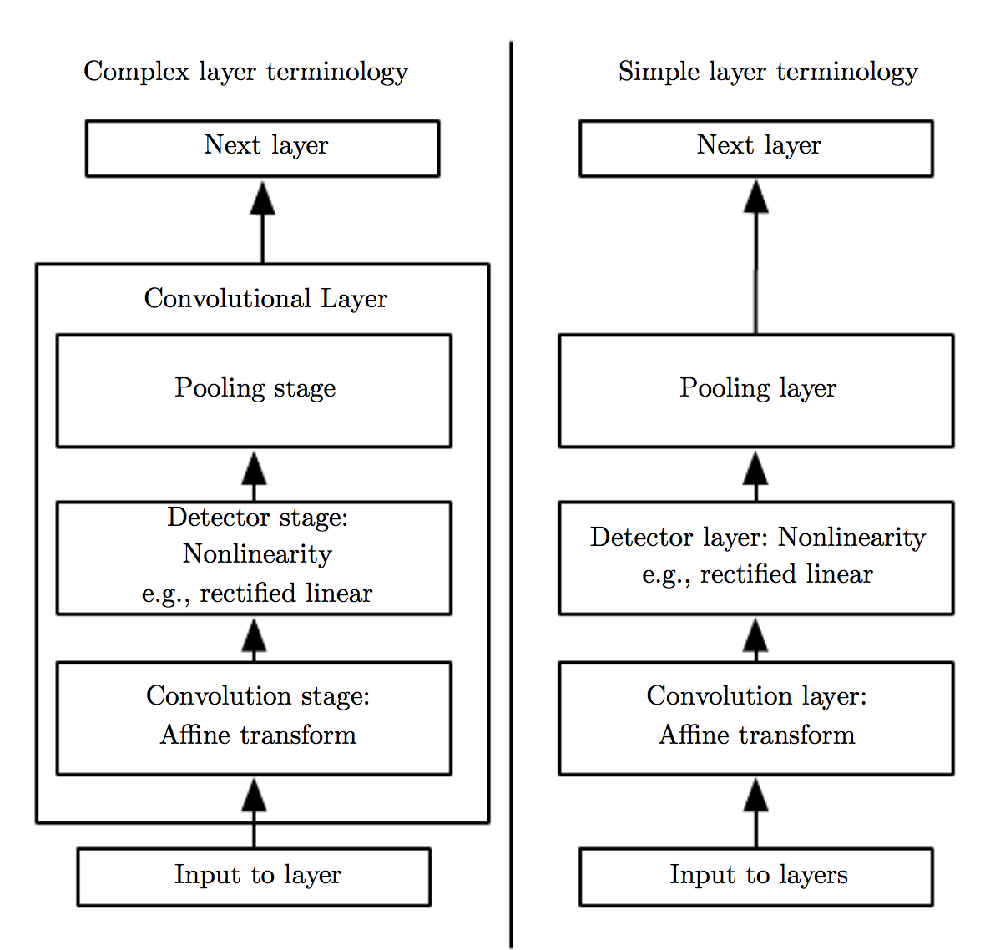
Two commonly used sets of terminology
The components of a typical convolutional neural network layer.
Left: viewed as a small number of relatively complex layers, with each layer having many “stages”.
Right: viewed as a larger number of simple layers; every step of processing is regarded as a layer in its own right.

Slide 34
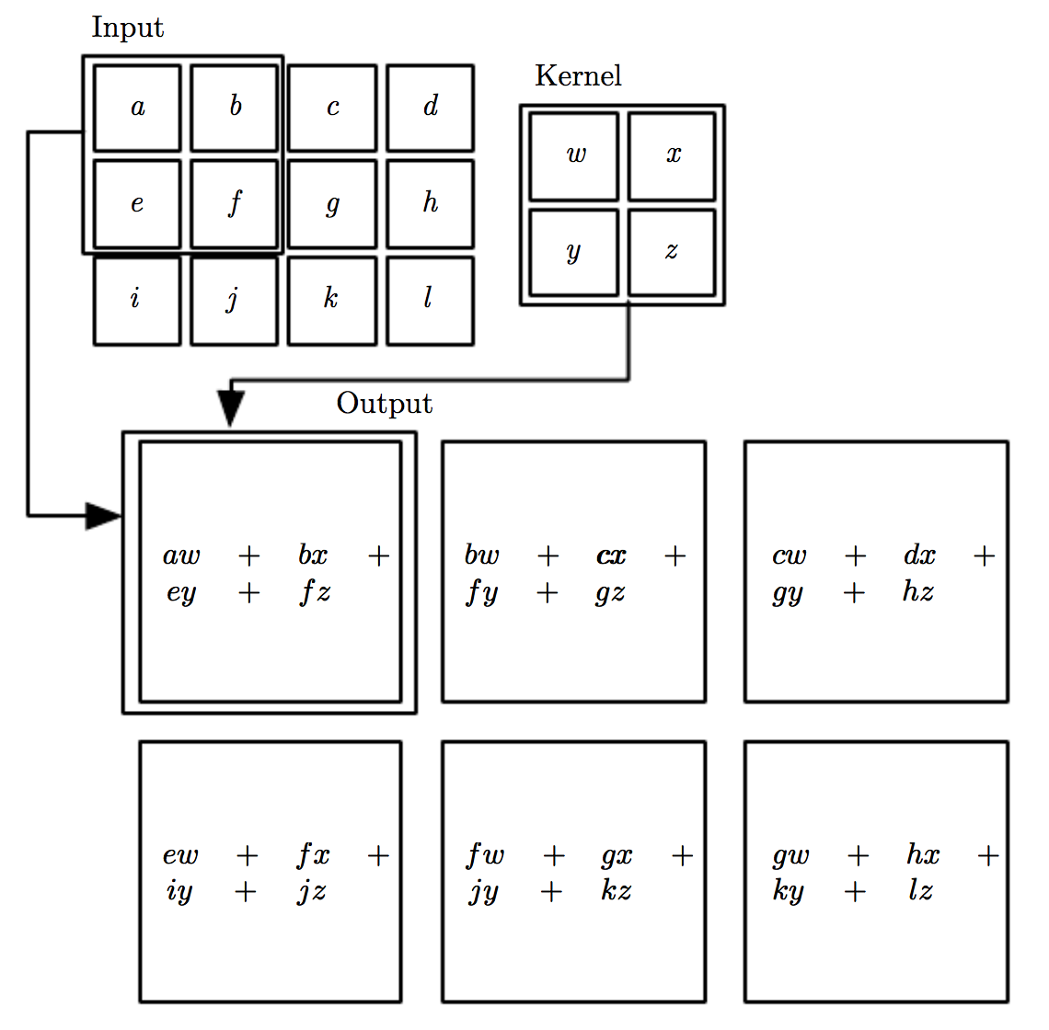
Recall: 2-D convolution w.o. kernel-flipping

Slide 35
Motivation of convolution
Convolution leverages three important ideas that can help improve a machine learning system:
Sparse Interactions
Parameter Sharing
Equivariant Representations

Slide 36
Motivation of convolution
Convolution leverages three important ideas that can help improve a machine learning system:
Sparse Interactions
Parameter Sharing
Equivariant Representations

Slide 37
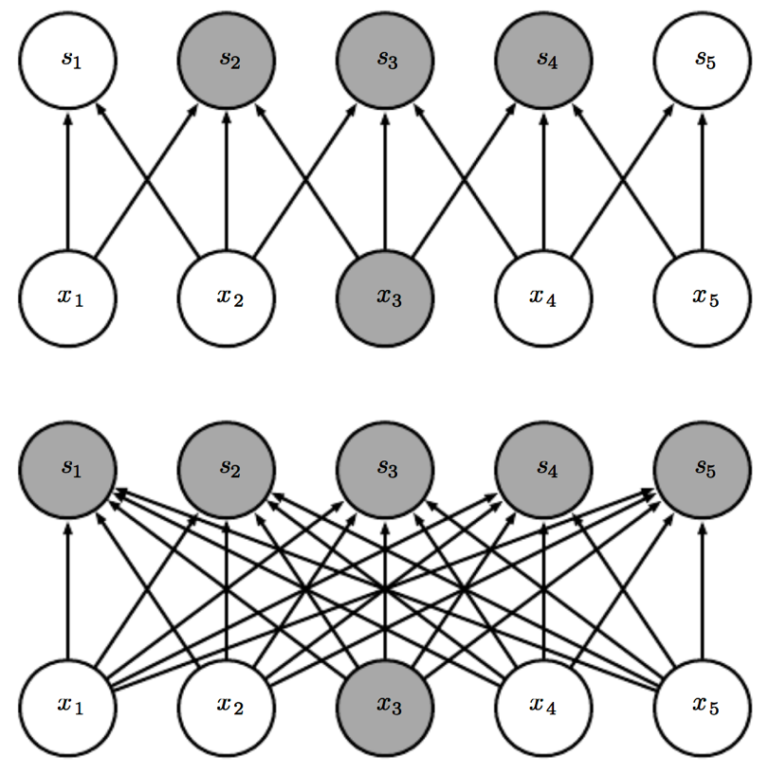
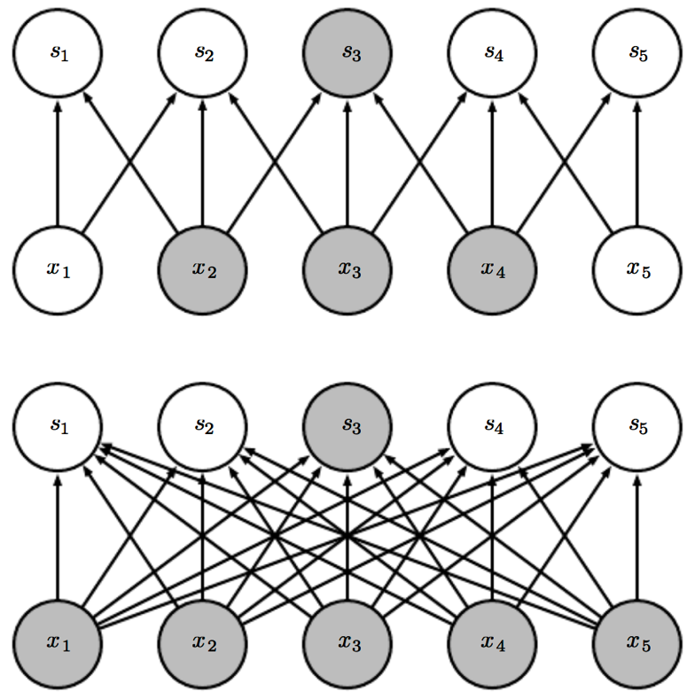
Sparse Interactions
Fully connected layers: every output unit interacts with every input unit.
Convolutional networks apply sparse interactions by making kernel smaller than the input.
O(kxn) runtime, and k<<m
Receptive field
O(mxn) runtime
Viewed from bottom.
Viewed from up.

Slide 38
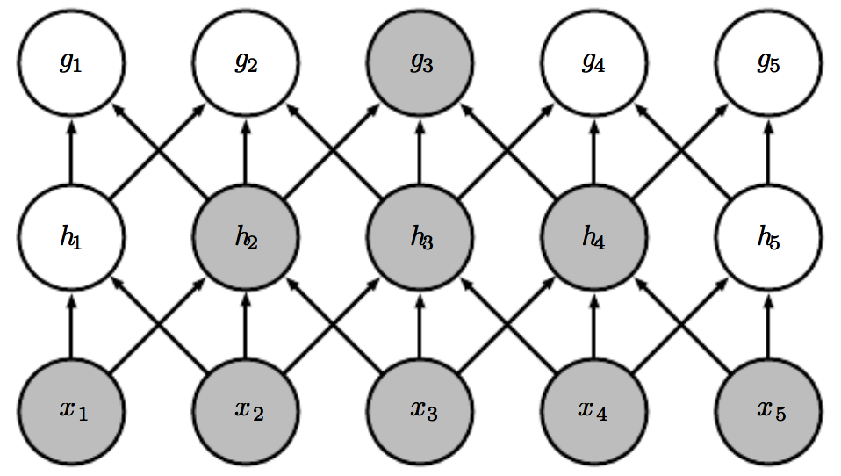
Sparse Connectivity
The receptive field of the units in the deeper layers of CNNs is larger than ones in the shallow layers.
This means that even though direct connections in CNNs are very sparse, units in the deeper layers can be indirectly connected to all or most of the input image.

Slide 39
Motivation of convolution
Convolution leverages three important ideas that can help improve a machine learning system:
Sparse Interactions
Parameter Sharing
Equivariant Representations

Slide 40
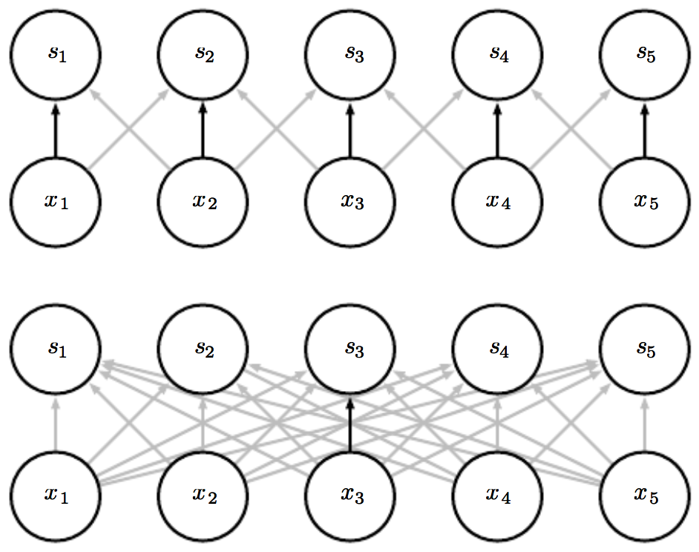
Parameter Sharing
Using the same parameter for more than one function in a model.
Traditional NNs: each element of the weight matrix is used exactly once when computing the output of a layer.
CNNs: tied weights. Reduced storage.
Shared weights.
Only once.

Slide 41
Motivation of convolution
Convolution leverages three important ideas that can help improve a machine learning system:
Sparse Interactions
Parameter Sharing
Equivariant Representations Equivariant in shift. If we move the object in 2D image input, its representation will move the same amount in the output.

Slide 42
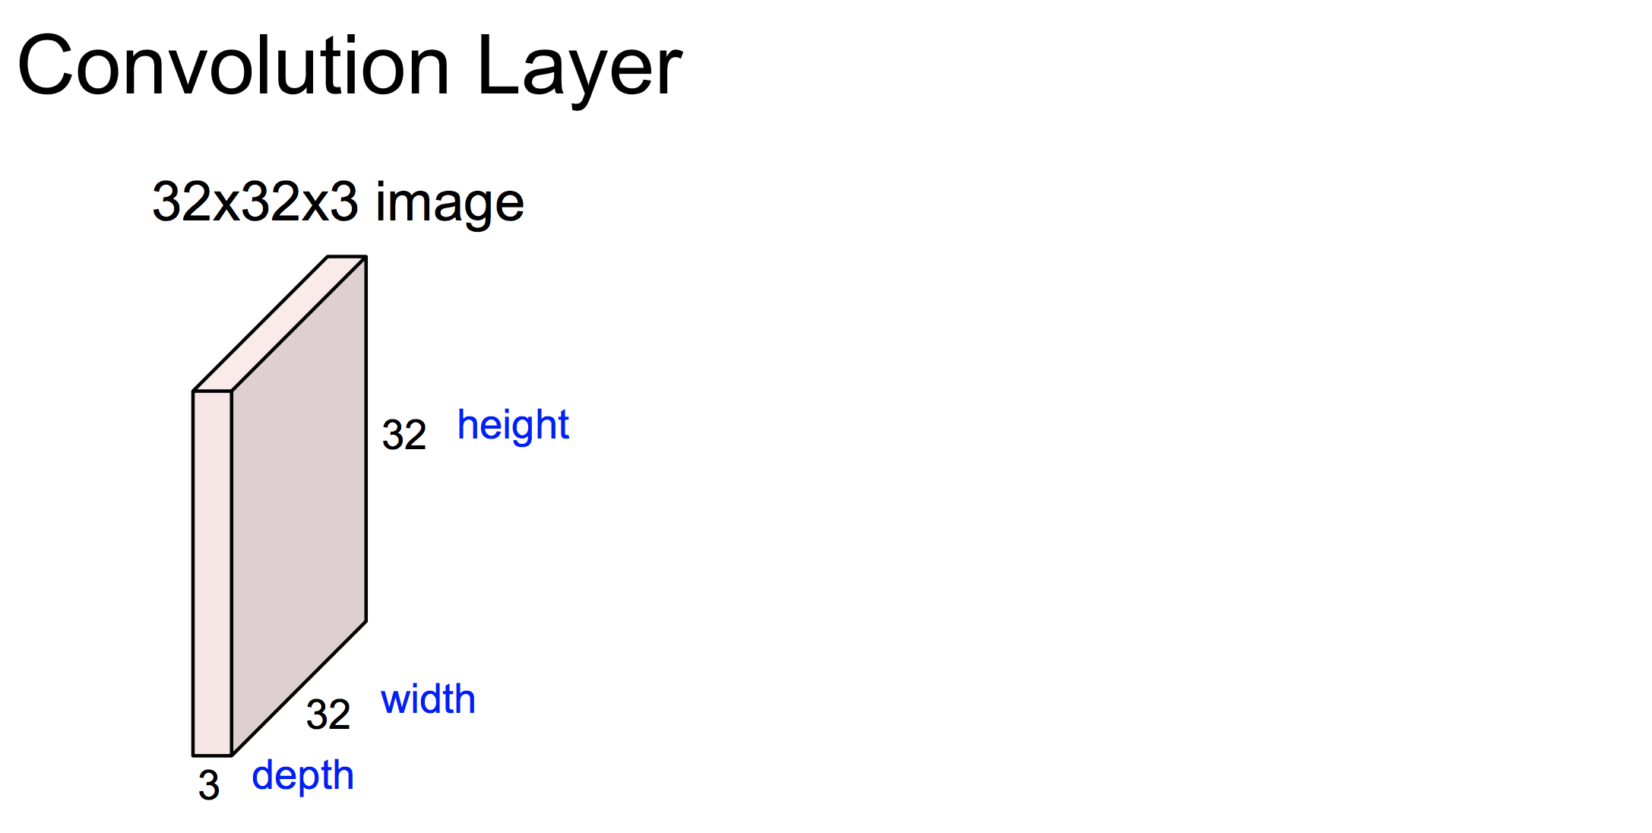
Example
Credit: Fei-Fei Li & Andrej Karpathy & Justin Johnson

Slide 43
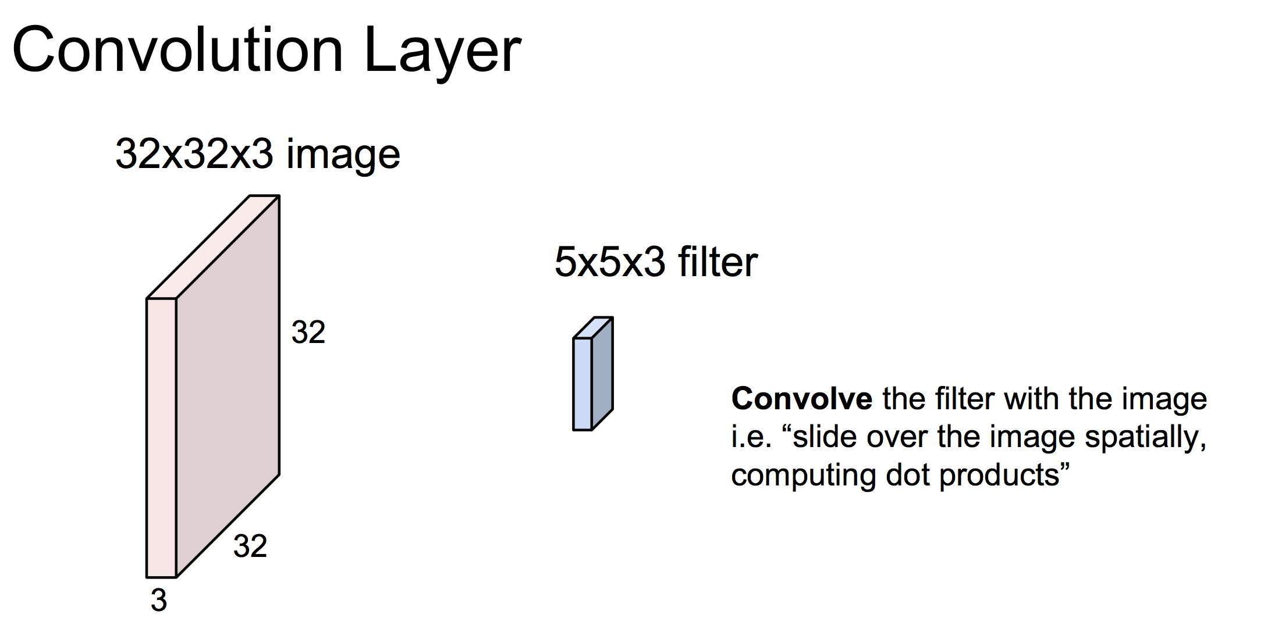
Credit: Fei-Fei Li & Andrej Karpathy & Justin Johnson

Slide 44
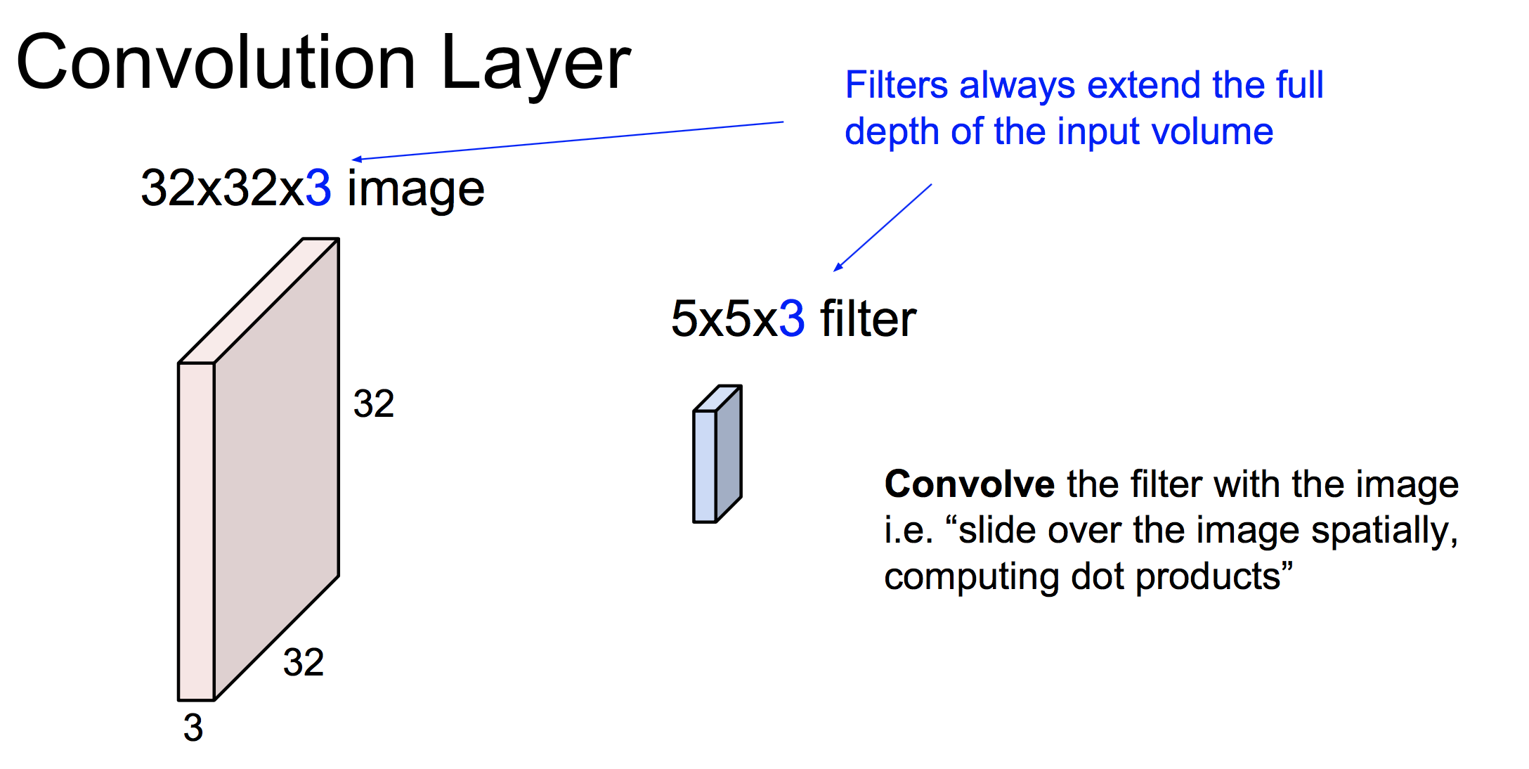
Credit: Fei-Fei Li & Andrej Karpathy & Justin Johnson

Slide 45
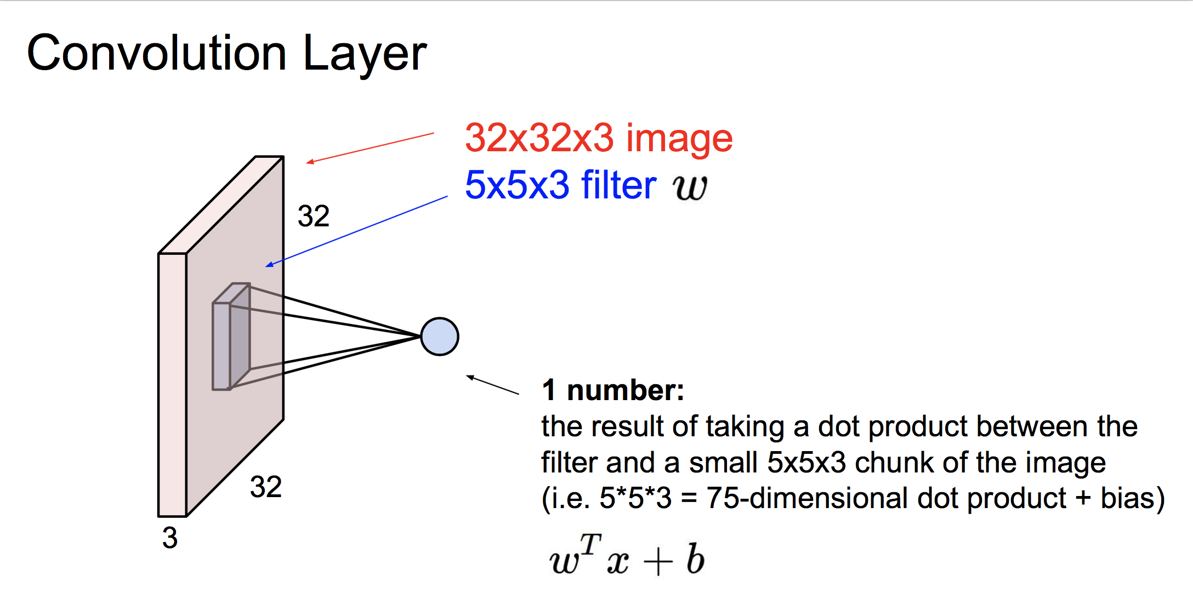
Credit: Fei-Fei Li & Andrej Karpathy & Justin Johnson

Slide 46

Credit: Fei-Fei Li & Andrej Karpathy & Justin Johnson

Slide 47

Credit: Fei-Fei Li & Andrej Karpathy & Justin Johnson

Slide 48

Credit: Fei-Fei Li & Andrej Karpathy & Justin Johnson

Slide 49

Credit: Fei-Fei Li & Andrej Karpathy & Justin Johnson

Slide 50

Credit: Fei-Fei Li & Andrej Karpathy & Justin Johnson

Slide 51

Credit: Fei-Fei Li & Andrej Karpathy & Justin Johnson

Slide 52

Credit: Fei-Fei Li & Andrej Karpathy & Justin Johnson

Slide 53

Credit: Fei-Fei Li & Andrej Karpathy & Justin Johnson

Slide 54

Credit: Fei-Fei Li & Andrej Karpathy & Justin Johnson

Slide 55

Credit: Fei-Fei Li & Andrej Karpathy & Justin Johnson

Slide 56
Pooling layer/stage

Slide 57

Pooling
Credit: Fei-Fei Li & Andrej Karpathy & Justin Johnson

Slide 58

Pooling
Invariant to what?
Invariant to small translations.
Invariance to local translation can be a very useful property if we care
more about whether some feature is present than exactly where it is.
Credit: Fei-Fei Li & Andrej Karpathy & Justin Johnson

Slide 59

Credit: Fei-Fei Li & Andrej Karpathy & Justin Johnson

Slide 60

Case Study: LeNet-5

Slide 61


Case Study: AlexNet
Go through two-GPUs!

Slide 62



Case Study: VGGNet

Slide 63



Case Study: GoogLeNet
Inception Module

Slide 64



Case Study: ResNet

Slide 65

ImageNet Challenges

Slide 66
Neural Network Interpretability
There is a growing trend of making CNNs interpretable to humans, i.e., opening up the black box.
Can you think of a few possible visualization methods?

Slide 67

Feature Visualization
Layer Activations: show the activations of the network during the forward pass.

Slide 68

A cool interactive demo
http://scs.ryerson.ca/~aharley/vis/conv/

Slide 69

Feature Visualization
Visualize the weights of Conv/FC Filters: these are usually most interpretable on the first CONV layer which is looking directly at the raw pixel data, but it is possible to also show the filter weights deeper in the network.

Slide 70

Feature Visualization
Retrieving images that maximally activate a neuron, and showing the receptive field of that neuron.

Slide 71

Feature Visualization
Embedding the codes with t-SNE, which preserves relative distance among samples in different embedding spaces.
E.g., Get 2-dimentional vector for each image based on the 4096-dimensional vector from AlexNet.

Slide 72

Feature Visualization
Embedding the codes with t-SNE, which preserves relative distance among samples in different embedding spaces.

Slide 73

Feature Visualization
Occluding parts of the image: as we slide the occluder over the image we record the probability of the correct class and then visualize it as a heatmap (shown below each image).

Slide 74
More Advanced Visualization
Visualization for given inputs: use backpropagation to highlight salient regions of the hidden units.
Activation maximization (AM) has been used by backpropagating on, and applying gradient ascent to, the input to find an image that increases the activity of some neuron of interest.

Slide 75
Next Week
Fitting
Textbook Sec. 4.3.2, 6.1.4, 6.1.1

